Slide 1




Slide 2

Test time on basic input,output,operators
URL:https://forms.gle/vLep53Dn1cNGn6ks9
QR CODE:

Slide 3

DECISION MAKING AND CONTROL STATEMENT

Slide 4
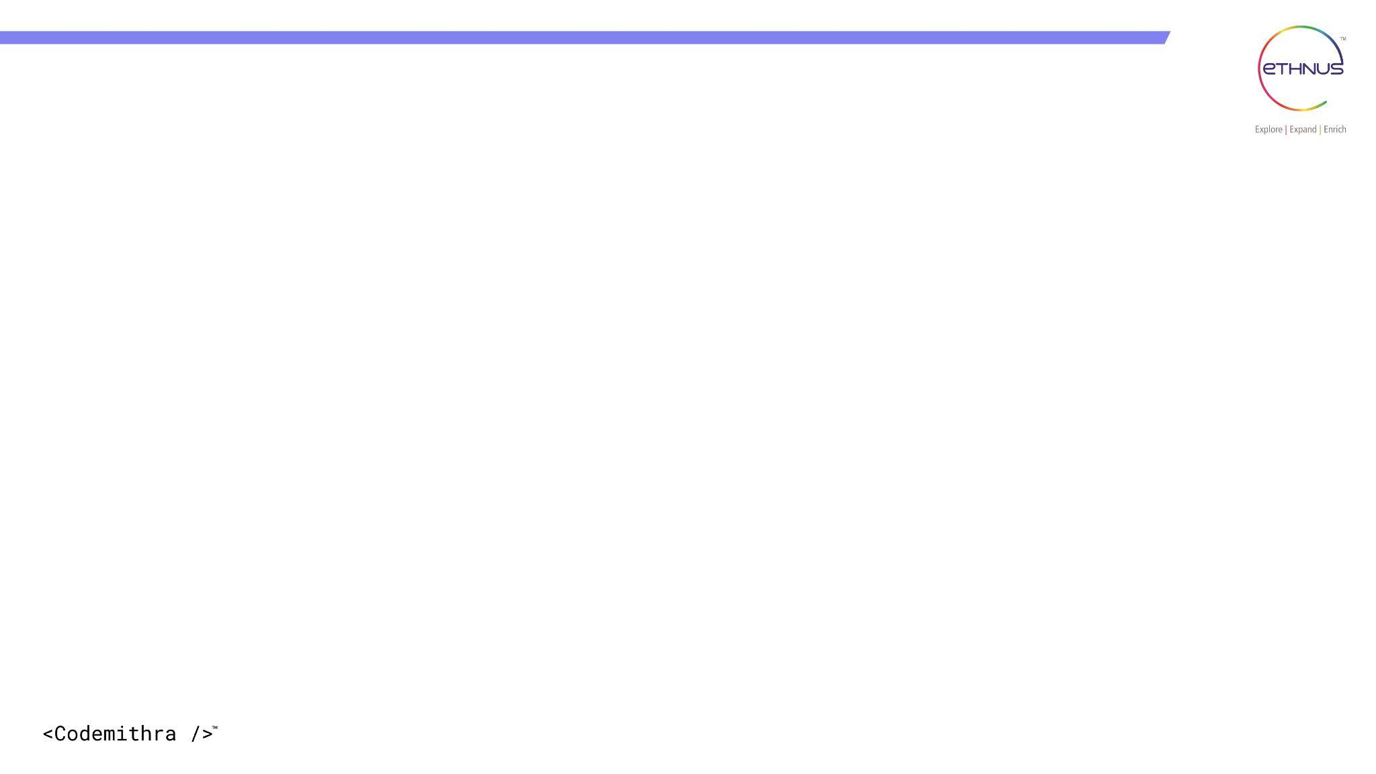

TOPICS
What is decision making?
If
If-else
If-else If-else statement
Switch
Ternary operator
Jump statements

Slide 5
What is decision-making?
Decision-making statements are used to control the flow of a program based on certain conditions. These statements allow you to make decisions and execute different blocks of code depending on whether a given condition is true or false.

Slide 6
1. if statement: The "if" statement is the fundamental decision-making statement. It evaluates a boolean expression inside the parentheses and executes the block of code within the curly braces if the condition is true.
if (condition) {
// Code to be executed if the condition is true
}

Slide 7
Example
public class Main {
public static void main(String[] args) {
int number = 10;
if (number > 5) {
System.out.println("The number is greater than 5.");
}
}
}

Slide 8
2.if-else statement: The "if-else" statement provides an alternative block of code to be executed when the condition is false.
if (condition) {
// Code to be executed if the condition is true
} else {
// Code to be executed if the condition is false
}

Slide 9
public class Main {
public static void main(String[] args) {
int number = 3;
if (number % 2 == 0) {
System.out.println("The number is even.");
} else {
System.out.println("The number is odd.");
}
}
}

Slide 10
3. if-else if-else statement: The "if-else if-else" statement allows you to chain multiple conditions together and execute different blocks of code based on the first condition that evaluates to true.
if (condition1) {
// Code to be executed if condition1 is true
} else if (condition2) {
// Code to be executed if condition 2 is true
} else {
// Code to be executed if all previous conditions are false
}

Slide 11
public class Main {
public static void main(String[] args) {
int score = 85;
if (score >= 90) {
System.out.println("A");
} else if (score >= 80) {
System.out.println("B");
} else if (score >= 70) {
System.out.println("C");
} else {
System.out.println("D");
}}}

Slide 12
4. switch statement: The "switch" statement provides an alternative way to handle multiple conditions based on the value of an expression. It allows you to choose a specific block of code to execute based on different possible values.
switch (expression) {
case value1:
// Code to be executed if the expression equals value1
break;
case value2:
// Code to be executed if the expression equals value2
break;
// More cases can be added here
default:
// Code to be executed if none of the cases match the expression
}

Slide 13
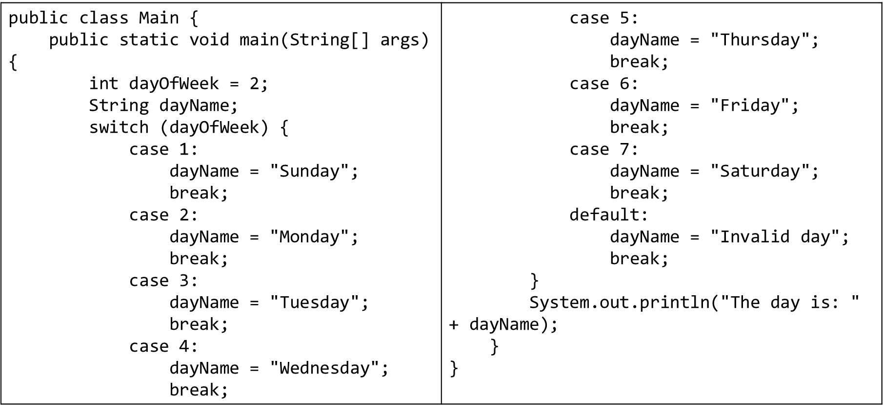

Slide 14
decision making statements
Ternary operator (?:):
It is a shorthand way to write simple if-else statements.
int num = 10;
String result = (num > 0) ? "Positive" : "Non-positive";
System.out.println(result);

Slide 15
decision making statements-Jump statements
There are three jump statements:
Break
Continue
Return
These statements are used to control the flow of a program and are typically used in loops and conditional blocks.

Slide 16
decision making statements-Jump statements
1. break: The `break` statement is used to exit a loop prematurely, even if the loop condition is not met. When the `break` statement is encountered, the control flow exits the loop, and the program continues with the statement after the loop.

Slide 17
Example
public class Main {
public static void main(String[] args) {
for (int i = 1; i <= 10; i++) {
if (i == 5) {
break; // Exit the loop when i becomes 5
}
System.out.println("Value: " + i);
}
}
}
Notes:
Value: 1
Value: 2
Value: 3
Value: 4

Slide 18
decision making statements-Jump statements
2. continue: The `continue` statement is used to skip the rest of the current iteration and continue with the next iteration of a loop. When the `continue` statement is encountered, the control flow jumps back to the loop's beginning to evaluate the loop condition again.

Slide 19
Example
public class Main {
public static void main(String[] args) {
for (int i = 1; i <= 5; i++) {
if (i == 3) {
continue; // Skip iteration when i is 3 and continue with the next iteration
}
System.out.println("Value: " + i);
}
}
}
Notes:
Value: 1
Value: 2
Value: 4
Value: 5

Slide 20
decision making statements-Jump statements
3.return: The `return` statement is used inside a method to terminate the method's execution and optionally return a value to the caller. When a `return` statement is encountered, the method's execution stops, and the control flow returns to the calling method.

Slide 21
Example
public class Main {
public static void main(String[] args) {
int num1 = 10;
int num2 = 20;
int result = add(num1, num2);
System.out.println("Sum: " + result);
}
public static int add(int a, int b) {
int sum = a + b;
return sum; // Return the sum to the caller
}
}
Notes:
sum:30

Slide 22
INTERVIEW QUESTIONS

Slide 23
Interview questions
1. What is control flow in Java, and why is it important in programming?
Answer: Control flow refers to the order in which statements in a program are executed. It’s essential for defining the logic and sequence of operations in a program.

Slide 24
Interview questions
Interview questions
2. What are the primary categories of control flow in Java?
Answer: The primary categories of control flow in Java are conditional statements, loops, and method calls.

Slide 25
Interview questions
Interview questions
3. Explain the ‘if’ statement in Java and its syntax.
Answer: The ‘if’ statement is used for conditional execution. Syntax:
if (condition) {
// Code to execute if condition is true
}

Slide 26
Interview questions
Interview questions
4. What is the purpose of the ‘else’ clause in an ‘if’ statement?
Answer: The ‘else’ clause is used to provide an alternative code block that executes when the ‘if’ condition is false.

Slide 27
Interview questions
Interview questions
5. What is the ‘else if’ statement in Java, and how is it used for multiple conditions?
Answer: The ‘else if’ statement allows you to specify multiple conditions in a chain, with each condition tested in sequence until one is true.

Slide 28
Interview questions
Interview questions
6. Explain the ‘switch’ statement in Java and its syntax.
Answer: The ‘switch’ statement is used to evaluate a variable against a list of values. Syntax: switch (variable) {
case value1:
// Code for value1
break;
case value2:
// Code for value2
break;
default:
// Code for default case
}

Slide 29
Practice questions
Question 1. Leap Year Checker:
Write a program to determine whether a given year is a leap year or not. A leap year is divisible by 4 but not by 100 unless it is also divisible by 400.
Sample Test Case:
Input: 2024
Output: Leap year
Input: 2100
Output: Not a leap year

Slide 30
Practice questions
Practice questions
Question 2. Grade Calculator:
Create a program that takes a student's score as input and outputs their corresponding grade based on the following criteria:
A: 90-100
B: 80-89
C: 70-79
D: 60-69
F: Below 60
Sample Test Case:
Input: 85
Output: B

Slide 31
Practice questions
Practice questions
Question 3. Factorial Calculator:
Write a program to calculate the factorial of a non-negative integer input by the user.
Sample Test Case:
Input: 5
Output: 120 (5! = 5 x 4 x 3 x 2 x 1 = 120)

Slide 32
Practice questions
Practice questions
Question 4. Number Guessing Game:
Implement a number guessing game where the computer generates a random number between 1 and 100, and the user has to guess it. Provide feedback to the user if their guess is too high or too low.
Sample Test Case:
Random number: 50
User's Guess: 30
Output: Too low. Try again.
User's Guess: 70
Output: Too high. Try again.
User's Guess: 50
Output: Congratulations! You guessed it right.

Slide 33
Practice questions
Practice questions
Question 5. Fibonacci Sequence Generator:
Write a program to generate the Fibonacci sequence up to a specified number of terms provided by the user.
Sample Test Case:
Input: 8
Output: 0 1 1 2 3 5 8 13

Slide 34




THANK YOU
+91 78150 95095
codemithra@ethnus.com
www.codemithra.com

